Slide 1
Week 5 Intro to NoSQL with MongoDB

Slide 2
Lesson 1 Modern General Purposes Databases

Slide 3
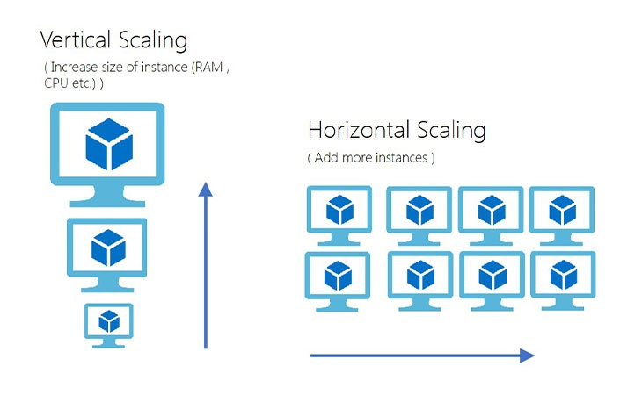
What is a general purpose database?
Used for meeting the needs of a variety of different applications
Not designed to manage any specific types of workloads
Designed to scale vertically thus limiting the amount of data that can be stored on them
Think Oracle, PostGres, MySQL, etc.

Slide 4
Modern Databases
What a modern database should do
Modern + general purpose databases
Supports a single unified API
Supports polymorphic data
Supports different types of workloads
Cloud native/SaaS
Easy mapping of the data to programming languages (classes, dicts, etc)
Supports a wide range of programming languages
Combines the concepts of general purpose with modern databases
Can be containerized
Can be provisioned in multiple cloud environments
Can support geolocation of data

Slide 5
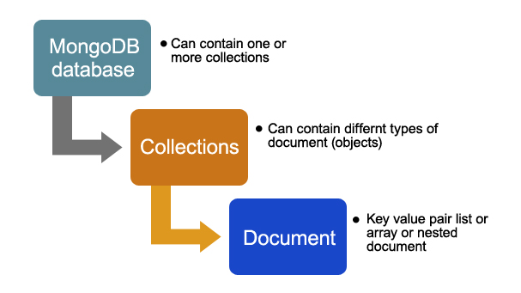
MongoDB as Modern General Purpose DB
API (Application Programming Interface)
MongoDB uses MQL (Mongo Query Language)
MongoDB stores data in BSON (JSON that has been compressed)
JSON is the standard data structure for modern applications
Replication allows for analytical workloads alongside transaction workloads

Slide 6
Lesson 2 Relational Vs Non-Relational Databases

Slide 7
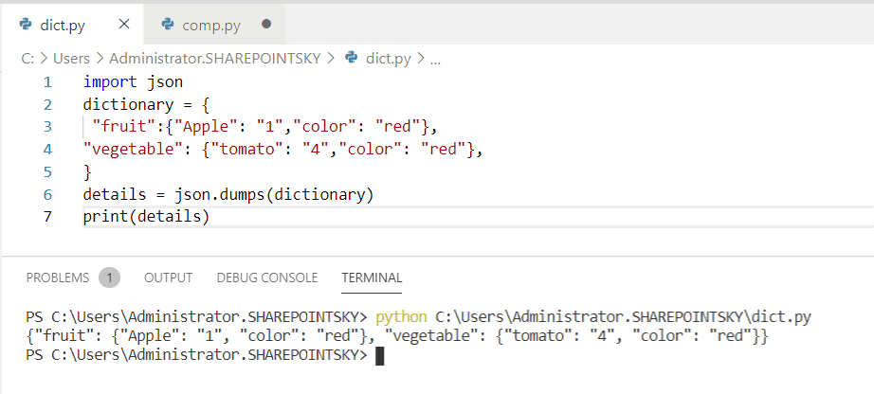
Non-Relational Databases
Originally defined as non-relational and this is our preferred definition (over NoSQL)
Modelled data in a different way to tabular models
Implicit recognition of horizontal scaling as an issue
“Eventual consistency” as a means of addressing consistency in Consistency Availability Partitioning (CAP theorem)
Less of mismatch between objects in a programming language and a table in a relational database sense

Slide 8
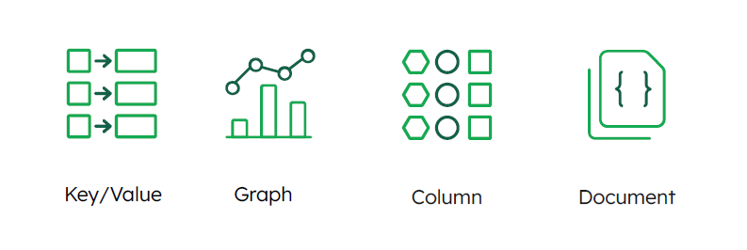
Lesson 3 Non-Relational Database Types

Slide 9
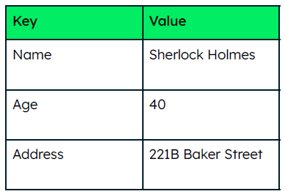
Key Value Database
Structure
A unique key is paired with a collection of values, where the values can be anything from a string to a large binary object.
Strength
Simple data model.

Slide 10
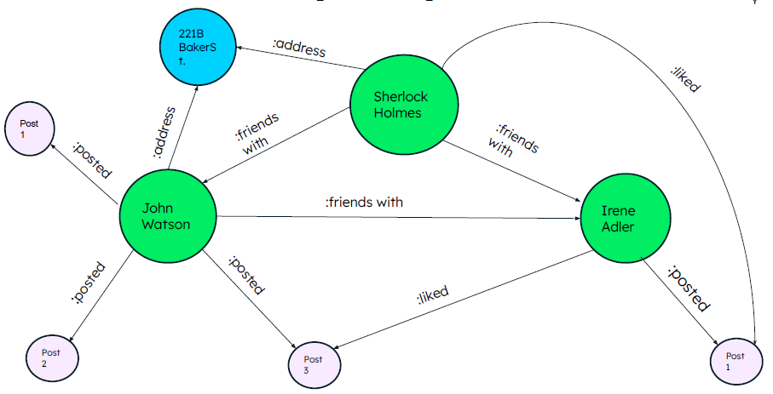
Graph Database
Structure
Captures connected data.
Each element is stored as a node.
Connections between nodes are called links or relationships.
Strength
Traverses the connections between data rapidly.

Slide 11
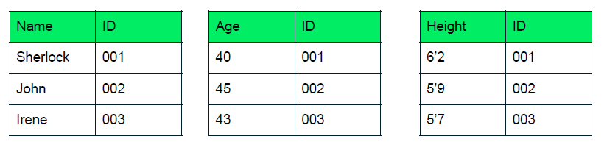
Column Oriented (Wide Column)
Structure
Data is stored using key rows that can be associated with one or more dynamic columns
Column keys as opposed to row keys (relational)
Strengths
Highly performant queries
Designed for analytics

Slide 12
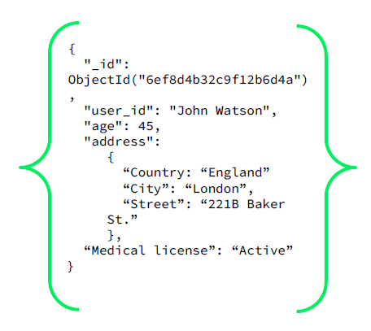
Document Database
Structure
Polymorphic data models
Each document contains markup that identifies fields and values.
Strengths
Obvious relationships using embedded arrays and documents
No complex mapping
Reduced redundancy over columnar/relational models
Collation of data

Slide 13
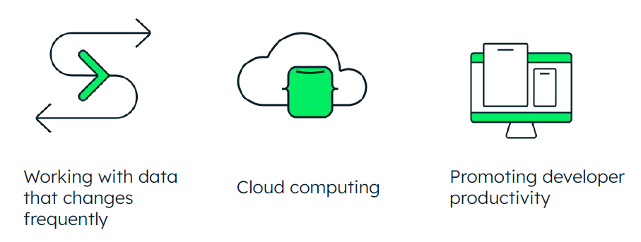
Lesson 4 When to Use Non-Relational Databases

Slide 14
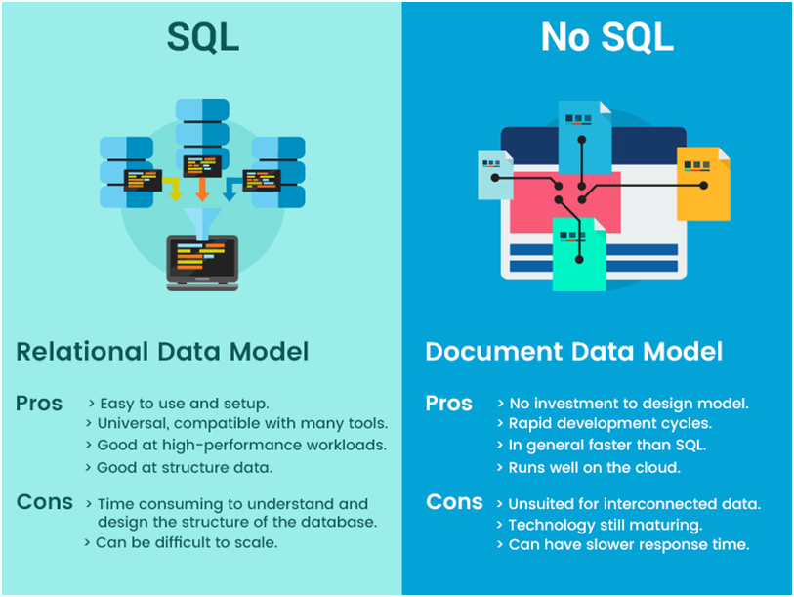
When to use NoSQL
When data changes frequently (polymorphism)
NoSQL models offer schema flexibility, meaning data can be different from document to document and change over time
Non-relational models offer increased developer flexibility
Increased productivity when developing data intensive applications
Horizontal and cloud scaling

Slide 15
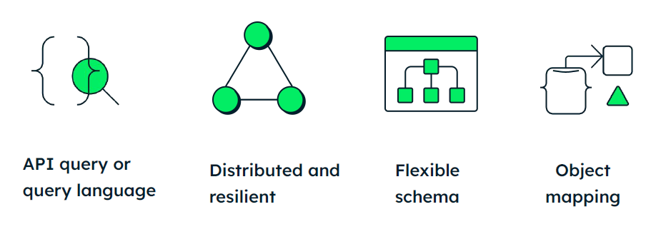
Lesson 5 The Document Model and MongoDB

Slide 16
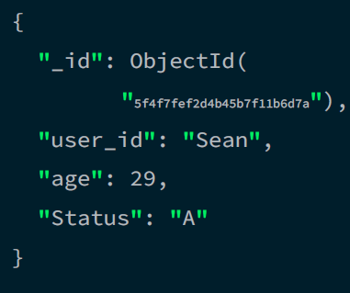
The Document Model
Queries are performed on ‘fields’ within each document
Object mapping – documents map to objects in most programming languages
In python this would be considered a dictionary
Flexible schema
Mongo allows for schema validation if necessary

Slide 17
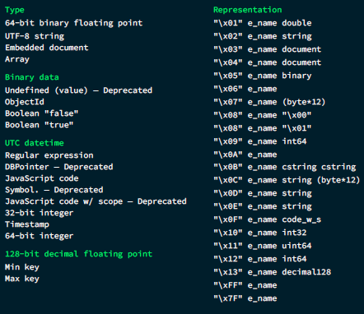
JSON & BSON
JSON
BSON
JavaScript Object Notation
Human-readable
Designed to be easy to read and write.
Familiarity
Based on two data structures: the ordered list and the object of namevalue pairs.
Very well known to all programmers.
Text format Encoding/decoding data in text to allow for data interchange.
JSON is space and speed inefficient.
Binary-encoded serialization of JSON-like documents.
Lightweight
Limits or removes any unnecessary bloat to keep data storage size optimal
Traversable
Quickly traverses across documents and fields within documents
Efficient
Encoding/decoding data quickly in order to improve throughput and computation

Slide 18
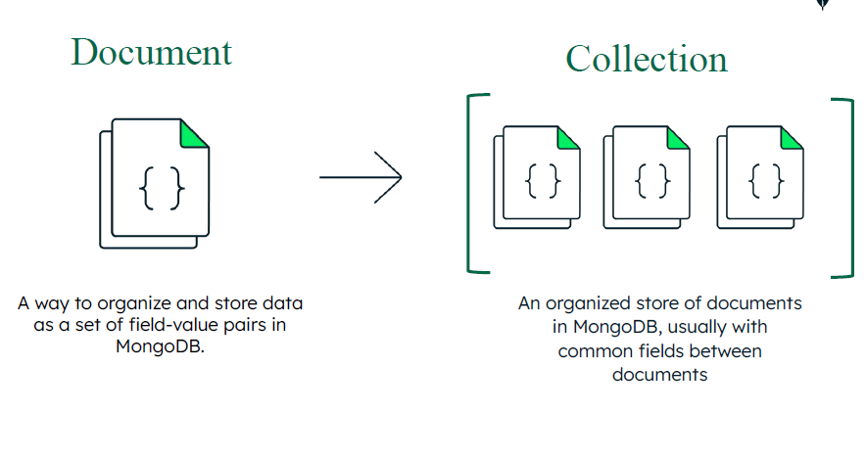
Collections in the Document Model
Collections
Groups of documents
An analogy in a relational database would be that a collection is a ‘table’ and documents are ‘rows’
Schema validation
Can be enforced on JSON (not BSON) documents
Allows constraints on incoming data to ensure a strict document schema is enforced

Slide 19
Lesson 6 A Developer Data Platform

Slide 20
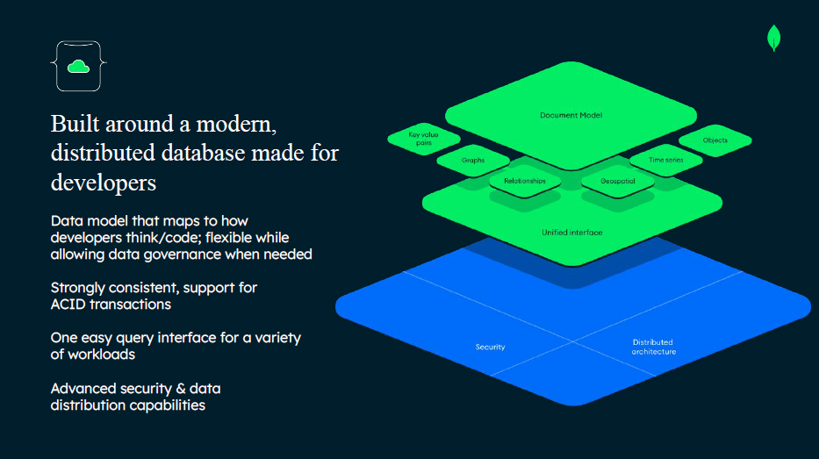

Slide 21
MongoDB Developer Tools
Compass
Atlas
An IDE for on-premises Mongo deployments
Visual data explorer
Visual query builder
Embedded MongoSh
An IDE for cloud-Mongo-managed deployments (DBaaS)
Atlas Charts
Continuous backup
Global & serverless cluster deployments

Slide 22
Lesson 7 MongoDB Architecture

Slide 23
Query Processing
App Request
Query Analyzer
Data Model
WiredTiger
Data Model
Application

Slide 24
Important Aspects of a Database
Correctness
Programming errors cannot change the database
Latency
How long it takes the DB to serve a request
Throughput
The number of operations the DB can serve at any moment
Scalability
How the database manages when more data is added
Usability
The difficulty in interacting with the DB

Slide 25
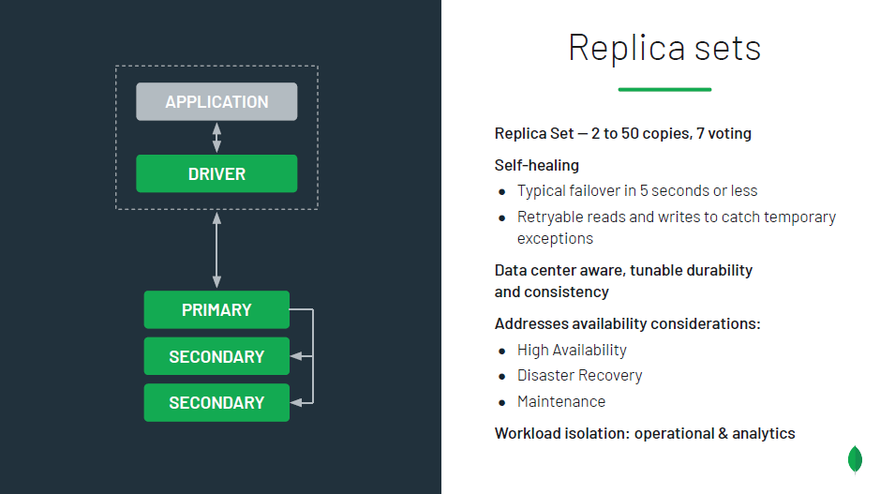
Replica Sets

Slide 26
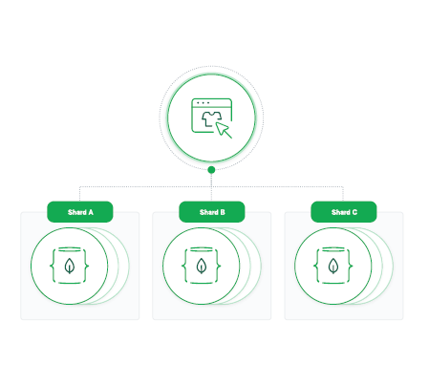
Sharding
Partitions the data across the Mongo cluster
Each shard consists of a replica set
Example: You could have a shard (partition) where each calendar Month is available on a single node
January node, February node, etc
The data could be daily, or even more granular, but the node/shard would contain data only for that month

